Slide 1
Python notebook using data Breast Cancer (Diagnostic) Data Set
Made By: Mayank Gupta(1/17/FET/BCS/026), Japneet Singh(1/17/FET/BCS/031), Daksh Yadav(1/17/FET/BCS/050)
8CSA

Slide 2
INTRODUCTION
Breast cancer, the breast cancer that occurs most often in women, affects about 10% of women at some point in their lives. It is the second largest contributor to the death of women after lung cancer. 25% of all cancers in women, including 12% of all new cases, are caused by breast cancer.
Data mining is applied due to better predictability disease, reducing drug costs, improving the health of patient by renewing the quality of health care along with value saving people's lives through real-time decisions. Here it provides you, a performance analysis and comparison of precision in classification between algorithms like: Logistic Regression, SVM, Random Forest and Naive Bayes, being the main influencer data mining algorithms used in the research community.

Slide 3
PLATFORM USED
JUPYTER NOTEBOOK

Slide 4
AIM and Libraries used
Predict the breast cancer
Increasing in accuracy
Libraries we used here is:-
>Pandas
>Numpy
>Matplotlib
>Seaborn
>Scipy
>Math
>PathLib
>skLearn

Slide 5
Dataset Description
1-ID number
2-diagnosis
The diagnosis of breast tissues (M = malignant, B = benign)
3-radius_mean
mean of distances from center to points on the perimeter
4-texture_mean
standard deviation of gray -scale values
5-perimeter_mean
mean size of the core tumor.

Slide 6
6-area_mean
7-smoothness_mean
mean of local variation in radius lengths
8-compactness_mean
mean of perimeter^2 / area - 1.0
9-concavity_mean
mean of severity of concave portions of the contour
10-concave points_mean
mean for number of concave portions of the contour

Slide 7
Algorithms Used:-
Logistic Regression
Normalisation
Modelling using confusion matrix
SVM
Random Forest
XGBoost Model

Slide 8
Logistic Regression
Logistic regression is a statistical model that in its basic form uses a logistic function to model a binary dependent variable, although there are many more complex extensions.
Logistic regression is used to perform regression analysis. When the dependent variable is binary. It is a predictive analysis similar to all other regression analyzes.

Slide 9
Normalization
Normalization is a technique that is often applied as part of preparing data for machine learning. The goal of normalization is to change the values ​​of the numeric columns in the dataset to use a common scale, without distorting the differences in the value ranges or losing information.

Slide 10
Modelling using confusion matrix
A confusion matrix is ​​a table that is often used to describe the performance of a classification model (or "classifier") on a test data set for which the true values ​​are known. Allows visualization of the performance of an algorithm.
A confusion matrix is a summary of prediction results on a classification problem. The number of correct and incorrect predictions are summarized with count values and broken down by each class. This is the key to the confusion matrix.

Slide 11
SVM
Support Vector Machine (SVM) is a supervised machine learning algorithm that can be used for ranking or regression challenges. However, it is mainly used in classification problems. In the SVM algorithm, we graph each data item as a point in n-dimensional space (where n is the number of entities it has) with the value of each entity as the value of a particular coordinate.

Slide 12
Random Forest
Random forest is a supervised learning algorithm that is used for both classification and regression. However, it is mainly used for classification problems. As we know that a forest is made up of trees and more trees means a more robust forest. Similarly, the random forest algorithm creates decision trees on data samples and then gets the prediction of each of them and finally selects the best solution by voting. It is an ensemble method that is better than a single decision tree because it reduces the overfit by averaging the result.

Slide 13
XGBoost Model
XGBoost is an implementation of gradient boosted decision trees designed for speed and performance that is dominant competitive machine learning. XGBoost stands for Extreme Gradient Boosting.
XGBoost is a popular and efficient open-source implementation of the gradient boosted trees algorithm. Gradient boosting is a supervised learning algorithm, which attempts to accurately predict a target variable by combining the estimates of a set of simpler, weaker models.

Slide 14
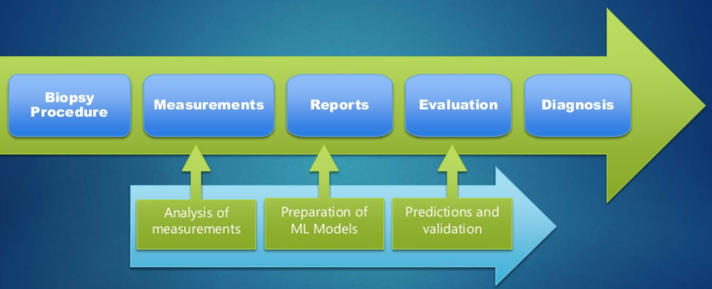
Flow of Data

Slide 15
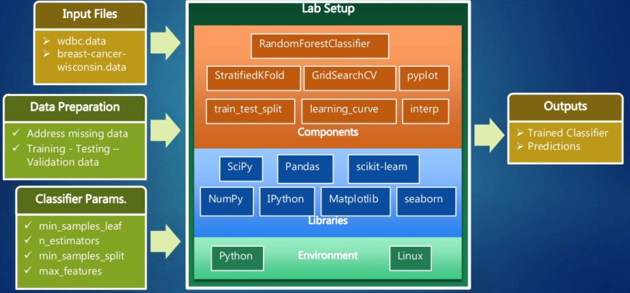
Analysis

Slide 16
DATA VISUALISATION

Slide 17
Data Description
i) Features are computed from a digitized image of a fine needle aspirate (FNA) of a breast mass.
> They Describe characteristics of the cell nuclei present in the image.
ii) The mean, standard error and worst or largest(mean of three largest values) of these features were computed for each image , resulting in 30 features.

Slide 18
1) ID number
2) Diagnosis (M = malignant, B = benign)
Ten real-valued features are computed for each cell nucleus:
a) radius (mean of distances from center to points on the perimeter)
b) texture (standard deviation of gray-scale values)
c) perimeter
d) area
e) smoothness (local variation in radius lengths)
f) compactness (perimeter^2 / area - 1.0)
g). concavity (severity of concave portions of the contour)
h). concave points (number of concave portions of the contour)
i). symmetry
j). fractal dimension ("coastline approximation" - 1)
3) Here 3- 32 are divided into three parts first is Mean (3-13), Stranded Error(13-23) and Worst(23-32) and each contain 10 parameter (radius, texture , area, perimeter, smoothness , compactness , concavity , concave points , symmetry and fractal dimension)
Here Mean means the means of the all cells, standard Error of all cell and worst means the worst cell

Slide 19
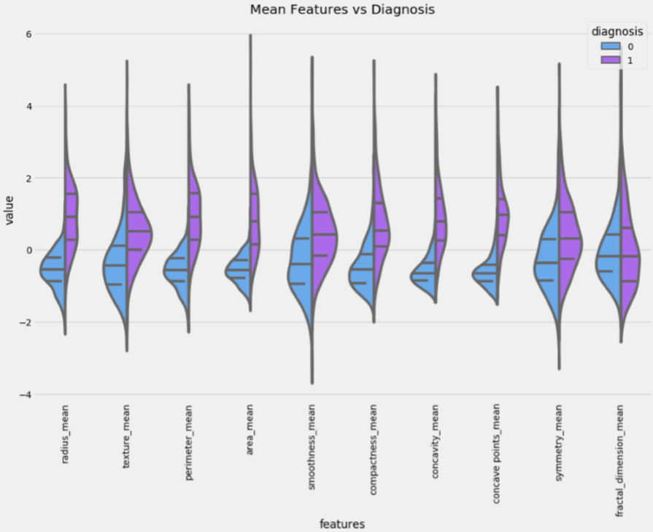
Mean Features vs. Diagnosis:

Slide 20
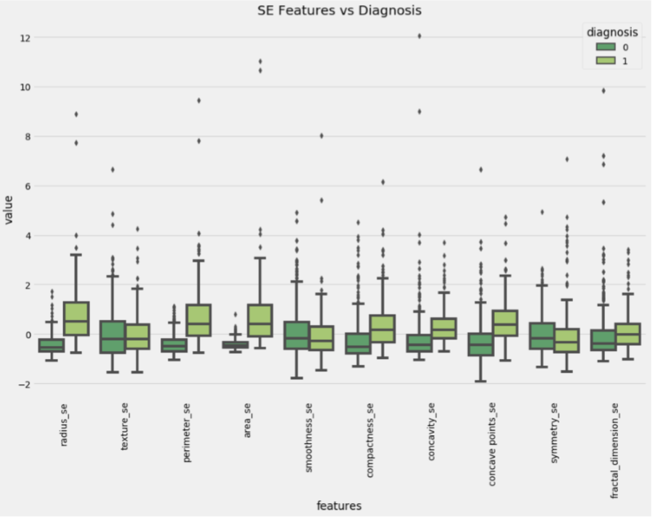
SE vs. Diagnosis:

Slide 21
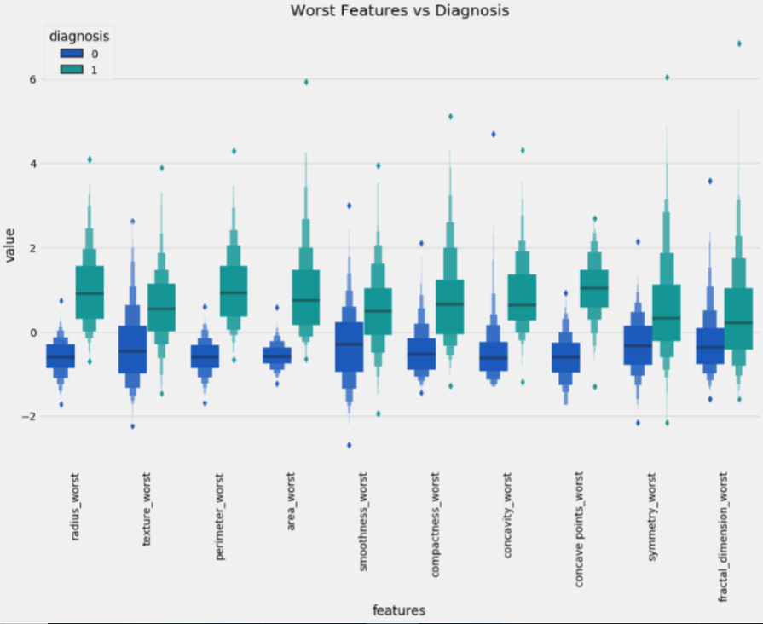
Worst Features vs. Diagnosis:

Slide 22
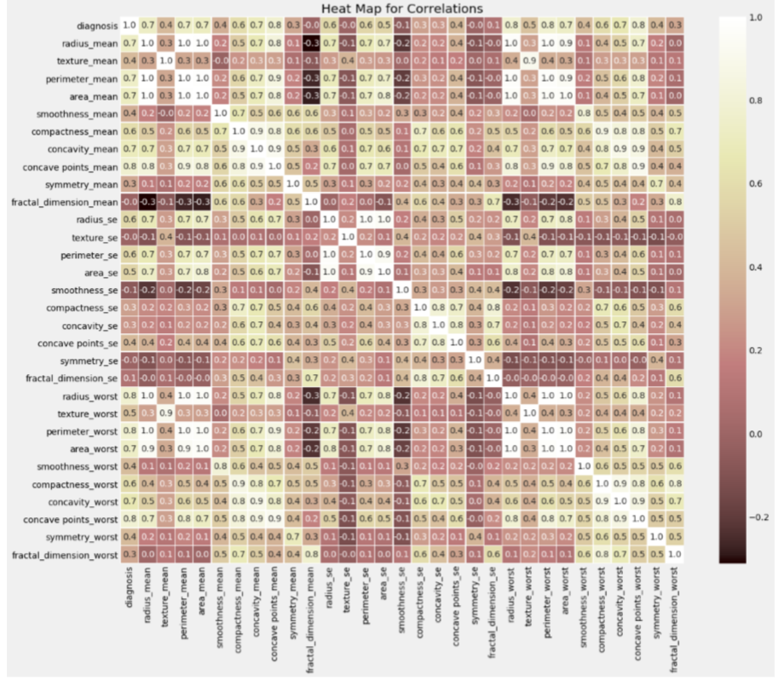
Heat Map for Correlations:

Slide 23
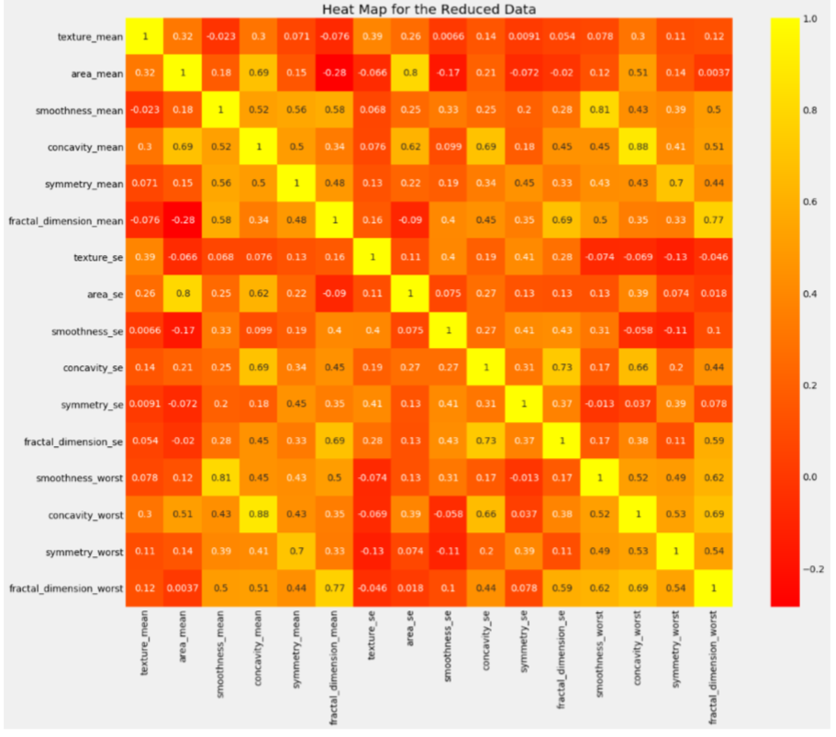
Heat Map for the Reduced Data:

Slide 24
RESULTS::-

Slide 25
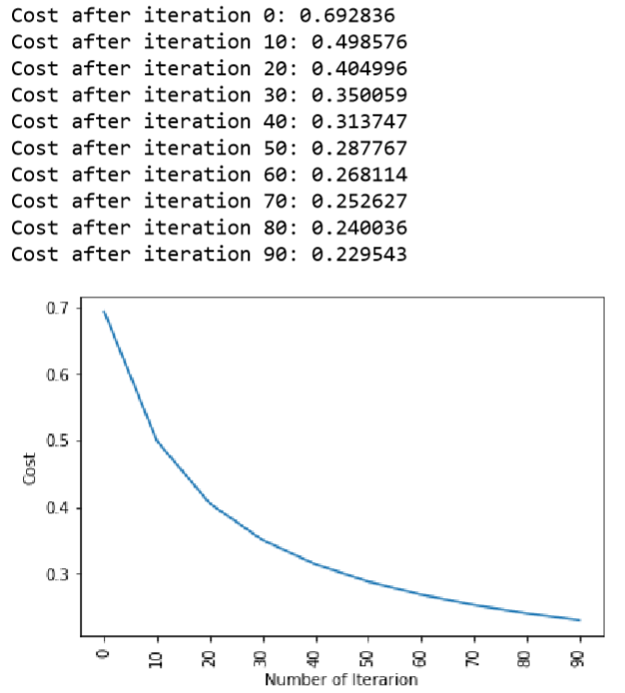
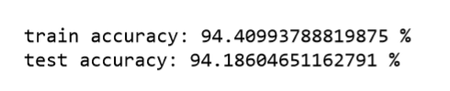
Cost After Iteration:

Slide 26
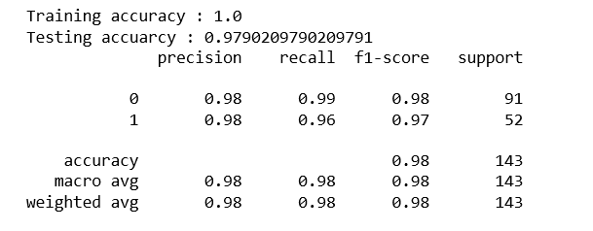
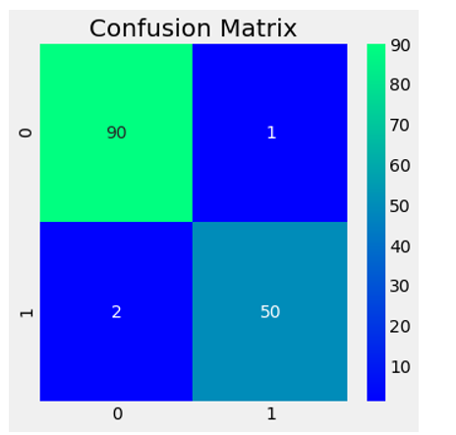
Confusion Matrix:-

Slide 27
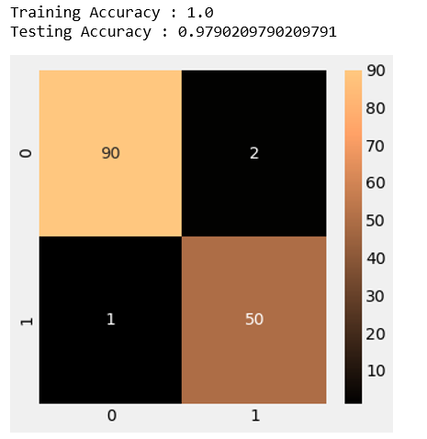
RFCEV ( Random_ForestClassifier() ):-

Slide 28
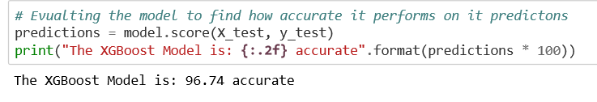
XGBoost Model

Slide 29
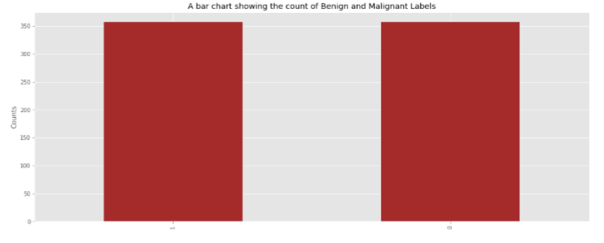
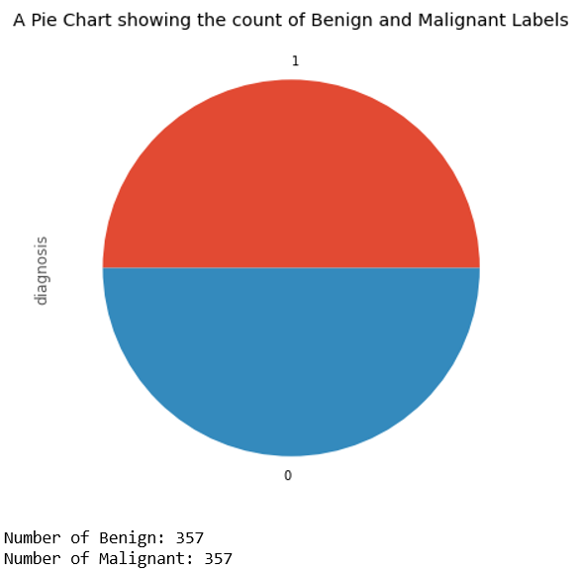
Data Pre-Processing

Slide 30
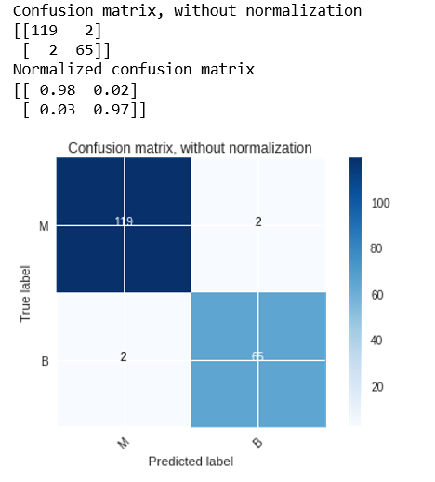
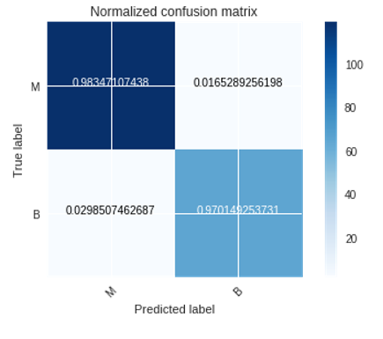
Breast Cancer Predictions using SVM

Slide 31
REFERENCES:-
Breast Cancer Prediction using Machine Learning(Sivapriya J, Aravind Kumar V, Siddarth Sai S, Sriram S) , https://www.ijrte.org/wp-content/uploads/papers/v8i4/D8292118419.pdf.
Machine Learning for Breast cancer diagnosis(P.K. Sharma), Slideshare,https://www.slideshare.net/PramodSharma73/machine-learning-breast-cancer-diagnosis
Logistic Regression, NCSS/Logistic_Regression.pdf, https://ncss-wpengine.netdna-ssl.com/wp-content/themes/ncss/pdf/Procedures/NCSS/Logistic_Regression.pdf
Analysis of a Random Forests Model (Analysis of a Random Forests Model Gerard Biau ´ LSTA & LPMA Universite Pierre et Marie Curie – Paris VI ´ Boˆıte 158, Tour 15-25, 2eme ` etage ´ 4 place Jussieu, 75252 Paris Cedex 05, France) (https://www.jmlr.org/papers/volume13/biau12a/biau12a.pdf)

Slide 32
XGBoost: A Scalable Tree Boosting System (XGBoost: A Scalable Tree Boosting System Tianqi Chen University of Washington tqchen@cs.washington.edu Carlos Guestrin University of Washington guestrin@cs.washington.edu) (https://www.kdd.org/kdd2016/papers/files/rfp0697-chenAemb.pdf)
Ahmad LG, Eshlaghy AT, Poorebrahimi A, Ebrahimi M and Razavi AR. Using Three Machine Learning Techniques for Predicting Breast Cancer Recurrence. Journal of Health & Medical Informatics
Seyyid Ahmed Medjahed, Tamazouzt Ait Saadi, Abdelkader Benyettou. Breast Cancer Diagnosis by using k-Nearest Neighbor with Different Distances and Classification Rules. International Journal of Computer Applications (0975 - 8887)
Abdelghani Bellaachia, Erhan Guven Predicting Breast Cancer Survivability Using Data Mining Techniques. 2006 SIAM Conference on Data Mining
Cuong Nguyen, Yong Wang, Ha Nam Nguyen Random forest classifier combined with feature selection for breast cancer diagnosis and prognostic. J. Biomedical Science and Engineering, 2013, 6, 551-560

Slide 33
Diana Dumitru. Prediction of recurrent events in breast cancer using the Naive Bayesian classification. 2000 Mathematics Subject Classification.
Turgay Ayer, MS; JagpreetChhatwal, PhD; OguzhanAlagoz, PhD; Charles E. Kahn, Jr, MD, MS; Ryan W. Woods, MD, MPH; Elizabeth S. Burnside, MD, MPH, MS. Comparison of Logistic Regression and Artificial Neural Network Models in Breast Cancer Risk Estimation. RadioGraphics 2010
JarceThongkam, Guandong Xu, Yanchun Zhang and Fuchun Huang. Breast Cancer Survivability via Adaboost Algorithm. HDKM '08 Proceedings of the second Australasian workshop on Health data and knowledge management

